Slide 1
Developing F# Applications From Domain Model to User Interface
Tomas Petricek
University of Cambridge
http://tomasp.net | @tomaspetricek

Slide 2
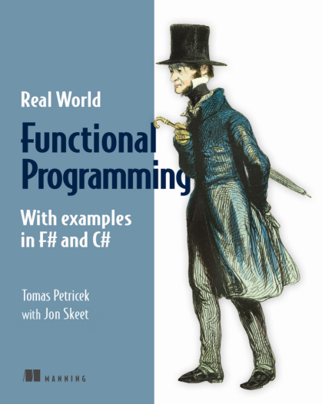
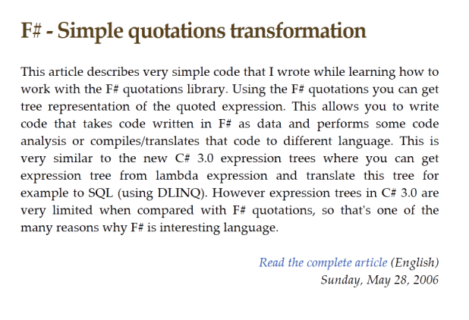

About me
Used F# before it was cool
Worked with the F# team
Did some F# research
Wrote F# & C# book
Doing F# trainings
… and more research

Slide 3
Domain on a single page

Slide 4
Example: Checkout counter

Slide 5
Demo: Counter domain

Slide 6
Domain on a single page
Aliases
Give name to a type
Tuples
Combine multiple values
Unions
Choice between options
Lists
Collections of values

Slide 7
Object-oriented and functional
Class hierarchy
Discriminated union
Adding functions difficult
Adding cases is easy
Adding cases difficult
Adding functions is easy
type Schedule =
| Never
| Once of DateTime
| Repeat of DateTime * TimeSpan

Slide 8
Transforming between representations

Slide 9
Multiple representations
While scanning
List of operations
Useful for
Fraud detection
Simple construction
Logging trades
Final receipt
List of products and quantities
Useful for
Print receipt
Quantity discounts

Slide 10
Multiple representations
Fraud?
Line items
Final
Log
Reciept

Slide 11
Demo: Transformations

Slide 12
The F# Development Process

Slide 13
The F# Development Process
Prototype
Develop
Think
Code

Slide 14
The F# Development Process
Prototyping
F# Interactive
Interactive tests
Verify behavior
Early as possible
Turn to unit tests
Development
.NET project
Unit tests
Test behavior
Continuously
NUnit, xUnit, etc.

Slide 15
Demo: Testing and projects

Slide 16
Accessing data in F# 3.0

Slide 17
F# 3.0 Type Providers
Language of the data
WSDL service, database schema
Meta-data describe structure
Language of the code
C# classes or F# data types
Languages do not understand the data!

Slide 18
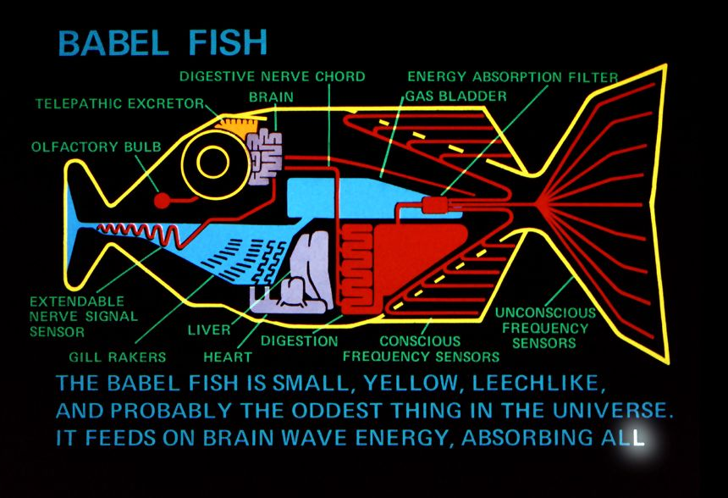
F# 3.0 Type Providers

Slide 19
Demo: Tesco web services

Slide 20
Creating user interfaces with F# async

Slide 21

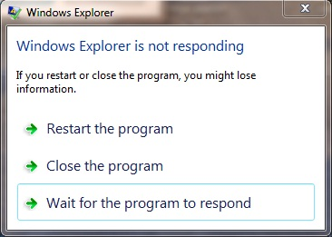
Asynchronous programming
On the server-side
On the client-side

Slide 22
Asynchronous programming
On the server-side
On the client-side
Threads are expensive
Scalability matters
Begin/End is hard
Keep code readable
Do not block the GUI
Experience matters
Events invert control
Keep code readable

Slide 23

Creating Traffic Lights
Using mutable state
Difficult to read
What are the transitions?
Encoding state machine
How to write this in code?

Slide 24
Async and Traffic Lights
Single cycle of the state machine
async {
let! md = Async.AwaitEvent this.MouseDown
display greenLight
let! md = Async.AwaitEvent this.MouseDown
display yellowLight
let! md = Async.AwaitEvent this.MouseDown
display redLight }

Slide 25
Async and Traffic Lights
Repeat the behavior forever
async {
while true do
let! md = Async.AwaitEvent this.MouseDown
display greenLight
let! md = Async.AwaitEvent this.MouseDown
display yellowLight
let! md = Async.AwaitEvent this.MouseDown
display redLight }

Slide 26
Async and Traffic Lights
Avoid code duplication using loops
async {
while true do
for color in [ green; yellow; red ] do
let! md = Async.AwaitEvent this.MouseDown
display color }

Slide 27
Demo: Creating GUI

Slide 28
Conclusions

Slide 29
Turning to the Functional Side
Domain on a single page
Start simple, end robust
Async everywhere

Slide 30

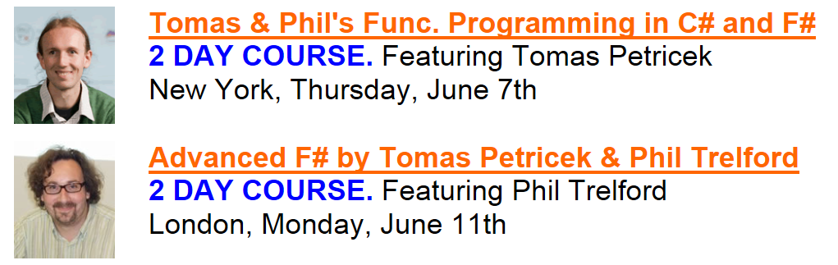
More F# in New York
www.skillsmatter.com | tomas@tomasp.net

